Slide 1
Pseudo-class Selector

Slide 2
Agenda
Pseudo-class Selector
Sample output
Pseudo-class Selector implementation

Slide 3
Pseudo-class Selector
Pseudo-class Selector is a special type of styling used on various elements.
This selector is used to style the element before or after an action is taken on those elements.
Syntax:
selector:pseudo-class {
property: value;
}

Slide 4
Pseudo-class Selector
Example :
Style elements when mouse hovers them
.class/id name : hover{
background-color: color_name;
}
Style links when based on visited and unvisited links
.selector:link{ // unvisited link
Property: value
}
.selector:visited{ // visited link
Property: value
}

Slide 5
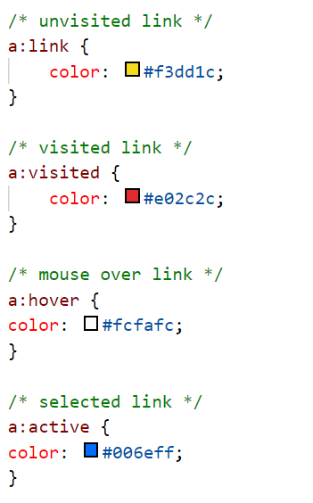
Sample output

Slide 6
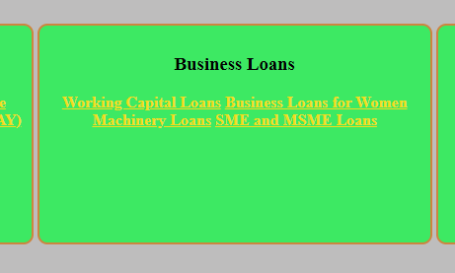
Sample output
When Unvisited

Slide 7
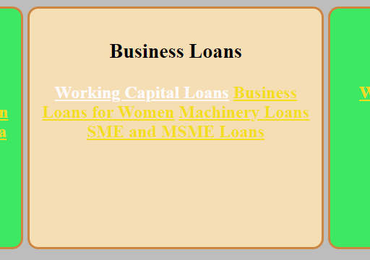
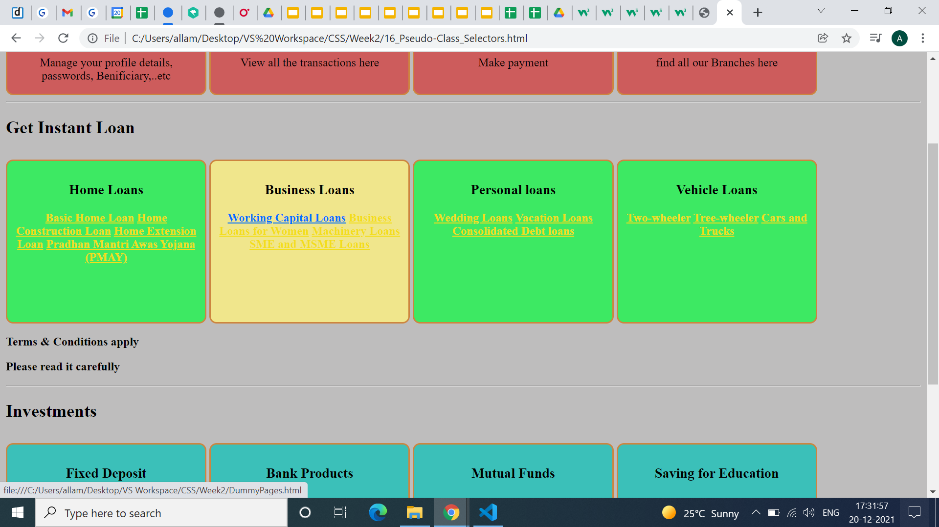
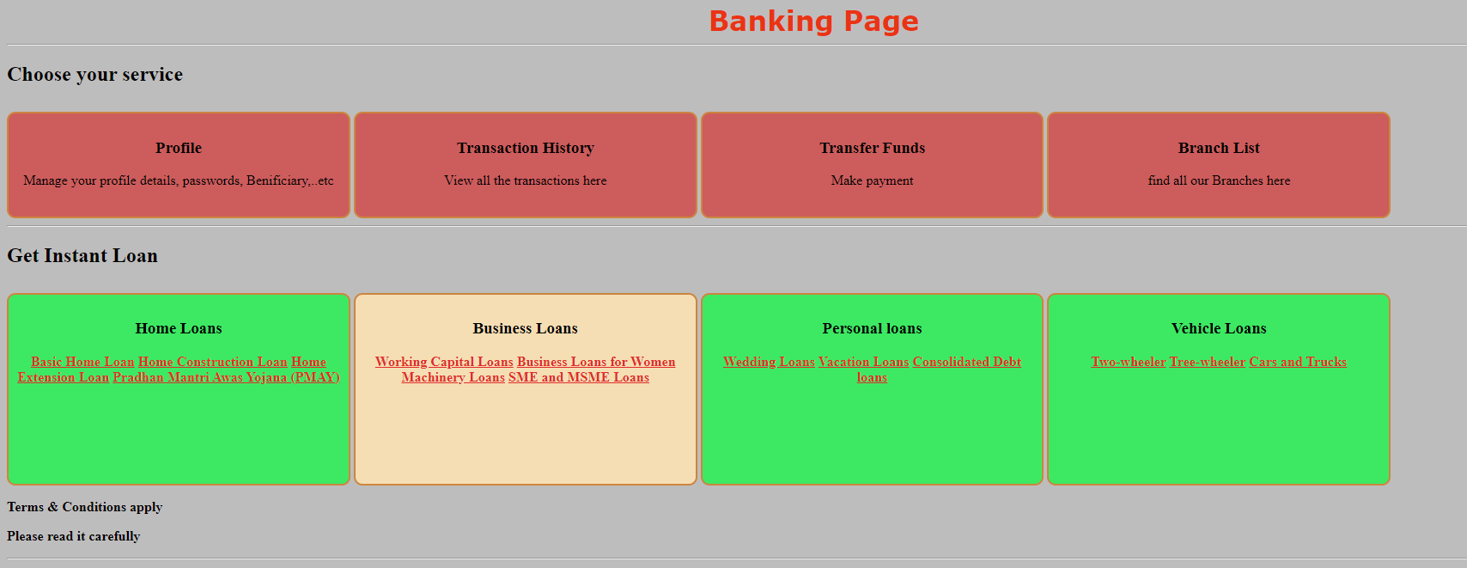
Sample output
When Hover
When Onclick
When Visited

Slide 8
Pseudo-class Selector
We have 31 Pseudo class Selectors in total. They are,
:active
:checked
:disabled
:enabled
:empty
:first-child
:first-of-type
:focus
:hover
:in-range
:invalid
:lang(language)
:last-child
:last-of-type
15. :link
16. :not(selector)
17. :nth-child(n)
18. :nth-last-child(n)
19. :nth-last-of-type(n)
20. :nth-of-type(n)
21. only-of-type
22. :only-child
23. :optional
24. :out-of-range
25. :read-only
26. :read-write
27. :required
28. :root
29. :target
30. :valid
31. :visited

Slide 9
Pseudo-class Selector implementation
Lets see an implementation for the same.

Slide 10
Summary
We have seen various types of Pseudo-class Selector which are hover, active, link visited.
DO NOT WRITE ANYTHING
HERE. LEAVE THIS SPACE FOR
WEBCAM

Slide 11
Thank You
Proprietary content. ©Great Learning. All Rights Reserved. Unauthorized use or distribution prohibited

